Slide 1


Slide 2
Chapter 14
Inventory Control
Notes:
2

Slide 3
OBJECTIVES
Inventory System Defined
Inventory Costs
Independent vs. Dependent Demand
Single-Period Inventory Model
Multi-Period Inventory Models: Basic Fixed-Order Quantity Models
Multi-Period Inventory Models: Basic Fixed-Time Period Model
Miscellaneous Systems and Issues
Notes:
2

Slide 4
Inventory System
Defined
Inventory is the stock of any item or resource used in an organization and can include: raw materials, finished products, component parts, supplies, and work-in-process
An inventory system is the set of policies and controls that monitor levels of inventory and determines what levels should be maintained, when stock should be replenished, and how large orders should be
Notes:
3

Slide 5
Purposes of Inventory
1. To maintain independence of operations
2. To meet variation in product demand
3. To allow flexibility in production scheduling
4. To provide a safeguard for variation in raw material delivery time
5. To take advantage of economic purchase-order size
Notes:
4

Slide 6
Inventory Costs
Holding (or carrying) costs
  Costs for storage, handling, insurance, etc
Setup (or production change) costs
  Costs for arranging specific equipment setups, etc
Ordering costs
  Costs of someone placing an order, etc
Shortage costs
  Costs of canceling an order, etc
Notes:
5

Slide 7
Independent vs. Dependent Demand
Independent Demand (Demand for the final end-product or demand not related to other items)
Finished
product
Dependent Demand
(Derived demand items for component parts,
subassemblies,
raw materials, etc)
E(1)
Component parts
Notes:
6

Slide 8
Inventory Systems
Single-Period Inventory Model
  One time purchasing decision (Example: vendor selling t-shirts at a football game)
  Seeks to balance the costs of inventory overstock and under stock
Multi-Period Inventory Models
  Fixed-Order Quantity Models
    Event triggered (Example: running out of stock)
  Fixed-Time Period Models
    Time triggered (Example: Monthly sales call by sales representative)
Notes:
7

Slide 9
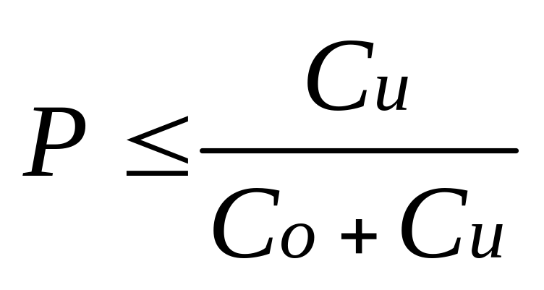
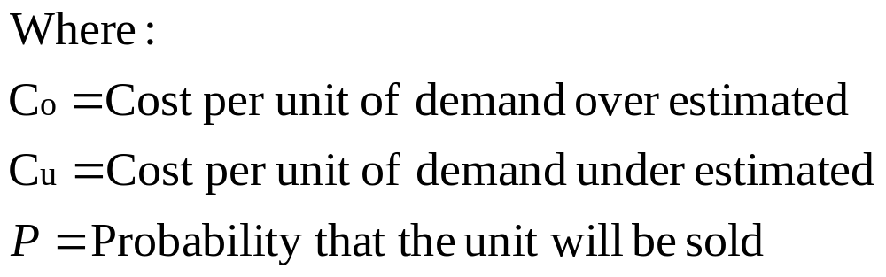
Single-Period Inventory Model
This model states that we should continue to increase the size of the inventory so long as the probability of selling the last unit added is equal to or greater than the ratio of: Cu/Co+Cu
Notes:
8

Slide 10
Single Period Model Example
Our college basketball team is playing in a tournament game this weekend. Based on our past experience we sell on average 2,400 shirts with a standard deviation of 350. We make $10 on every shirt we sell at the game, but lose $5 on every shirt not sold. How many shirts should we make for the game?
C_{u} = $10 and C_{o} = $5; P ≤ $10 / ($10 + $5) = .667
Z_{.667} = .432 (use NORMSDIST(.667) or Appendix E)
therefore we need 2,400 + .432(350) = 2,551 shirts

Slide 11
Multi-Period Models:
Fixed-Order Quantity Model Model Assumptions (Part 1)
Demand for the product is constant and uniform throughout the period
Lead time (time from ordering to receipt) is constant
Price per unit of product is constant

Slide 12
Multi-Period Models:
Fixed-Order Quantity Model Model Assumptions (Part 2)
Inventory holding cost is based on average inventory
Ordering or setup costs are constant
All demands for the product will be satisfied (No back orders are allowed)
Notes:
9

Slide 13
Basic Fixed-Order Quantity Model and Reorder Point Behavior
1. You receive an order quantity Q.
4. The cycle then repeats.
Number
of units
on hand
Q
Q
Q
R
L
L
2. Your start using them up over time.
3. When you reach down to a level of inventory of R, you place your next Q sized order.
Time
R = Reorder point
Q = Economic order quantity
L = Lead time

Slide 14
Cost Minimization Goal
By adding the item, holding, and ordering costs together, we determine the total cost curve, which in turn is used to find the Q_{opt} inventory order point that minimizes total costs
Total Cost
C
O
S
T
Holding
Costs
Annual Cost of
Items (DC)
Ordering Costs
Q_{OPT}
Order Quantity (Q)
Notes:
11

Slide 15
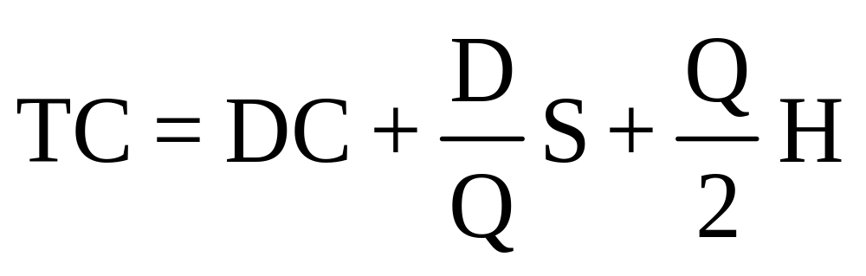
Basic Fixed-Order Quantity (EOQ) Model Formula
TC=Total annual cost
D =Demand
C =Cost per unit
Q =Order quantity
S =Cost of placing an order or setup cost
R =Reorder point
L =Lead time
H=Annual holding and storage cost per unit of inventory
Total
Annual =
Cost
Annual
Purchase
Cost
Annual
Ordering
Cost
Annual
Holding
Cost
+
+
Notes:
12

Slide 16
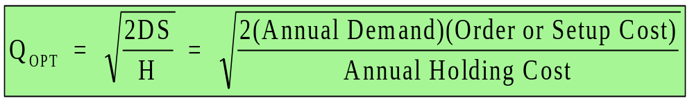
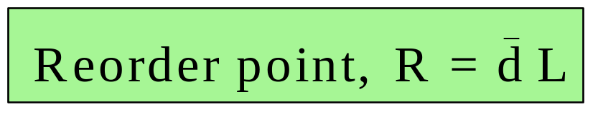
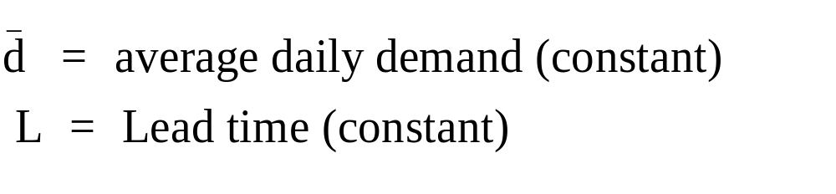
Deriving the EOQ
Using calculus, we take the first derivative of the total cost function with respect to Q, and set the derivative (slope) equal to zero, solving for the optimized (cost minimized) value of Q_{opt}
We also need a reorder point to tell us when to place an order
Notes:
13

Slide 17
EOQ Example (1) Problem Data
Given the information below, what are the EOQ and reorder point?
Annual Demand = 1,000 units
Days per year considered in average
daily demand = 365
Cost to place an order = $10
Holding cost per unit per year = $2.50
Lead time = 7 days
Cost per unit = $15
Notes:
14

Slide 18
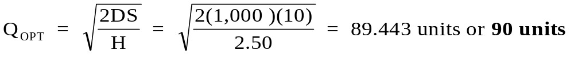
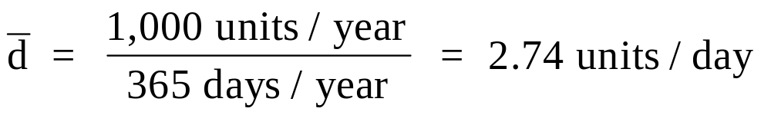
EOQ Example (1) Solution
In summary, you place an optimal order of 90 units. In the course of using the units to meet demand, when you only have 20 units left, place the next order of 90 units.
Notes:
15

Slide 19
EOQ Example (2) Problem Data
Determine the economic order quantity
and the reorder point given the following…
Annual Demand = 10,000 units
Days per year considered in average daily demand = 365
Cost to place an order = $10
Holding cost per unit per year = 10% of cost per unit
Lead time = 10 days
Cost per unit = $15
Notes:
16

Slide 20
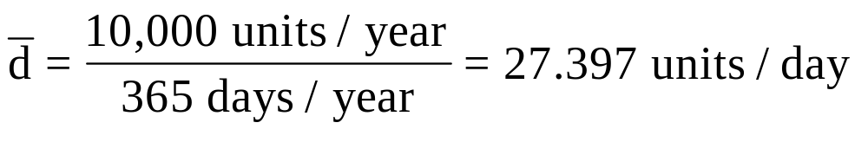
EOQ Example (2) Solution
Place an order for 366 units. When in the course of using the inventory you are left with only 274 units, place the next order of 366 units.
Notes:
17

Slide 21
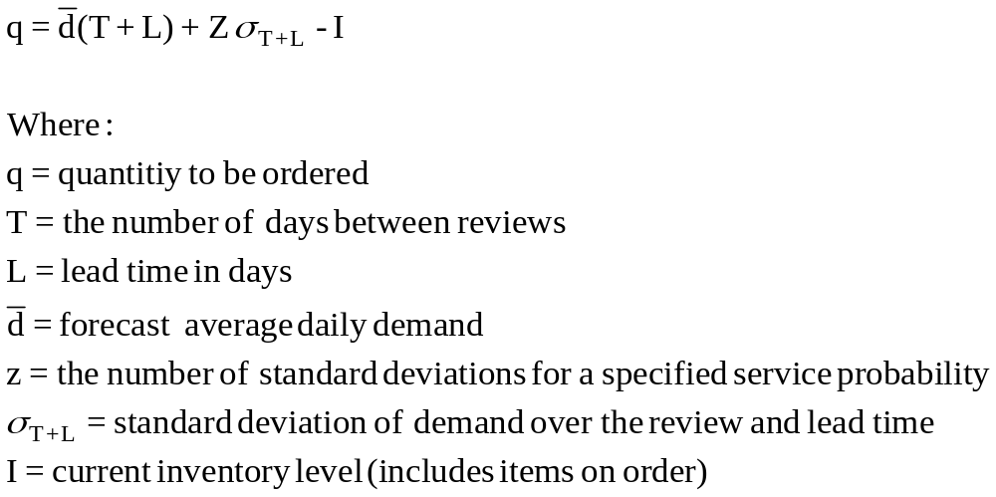
Fixed-Time Period Model with Safety Stock Formula
q = Average demand + Safety stock – Inventory currently on hand
Notes:
18

Slide 22
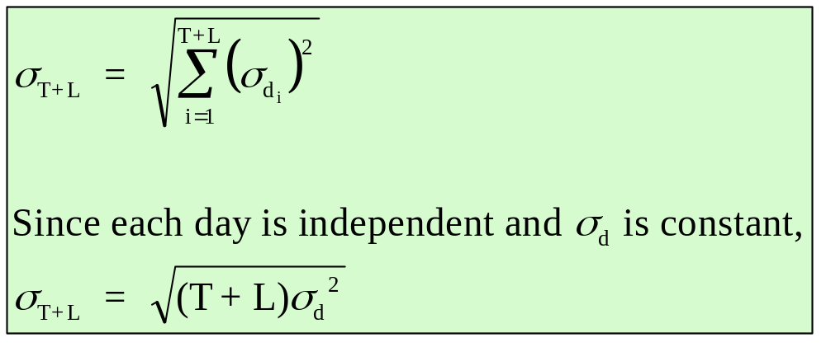
Multi-Period Models: Fixed-Time Period Model:
Determining the Value of σ_{T+L}
The standard deviation of a sequence of random events equals the square root of the sum of the variances
Notes:
20

Slide 23
Example of the Fixed-Time Period Model
Given the information below, how many units should be ordered?
Average daily demand for a product is 20 units. The review period is 30 days, and lead time is 10 days. Management has set a policy of satisfying 96 percent of demand from items in stock. At the beginning of the review period there are 200 units in inventory. The daily demand standard deviation is 4 units.
Notes:
21

Slide 24
Example of the Fixed-Time Period Model: Solution (Part 1)
The value for “z” is found by using the Excel NORMSINV function, or as we will do here, using Appendix D. By adding 0.5 to all the values in Appendix D and finding the value in the table that comes closest to the service probability, the “z” value can be read by adding the column heading label to the row label.
So, by adding 0.5 to the value from Appendix D of 0.4599, we have a probability of 0.9599, which is given by a z = 1.75
Notes:
22

Slide 25
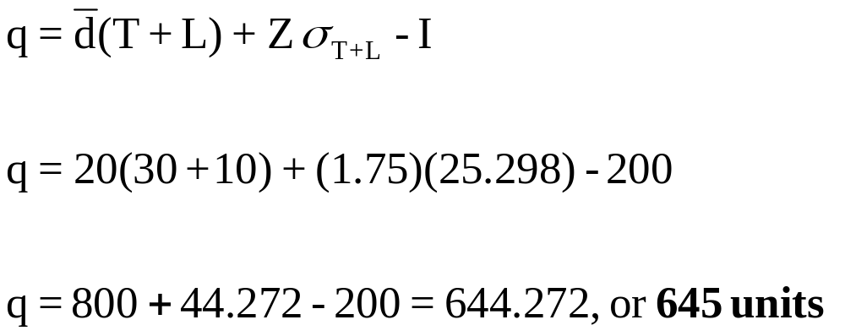
Example of the Fixed-Time Period Model: Solution (Part 2)
So, to satisfy 96 percent of the demand, you should place an order of 645 units at this review period
Notes:
23

Slide 26
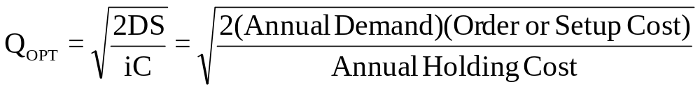
Price-Break Model Formula
Based on the same assumptions as the EOQ model, the price-break model has a similar Q_{opt} formula:
i = percentage of unit cost attributed to carrying inventory
C = cost per unit
Since “C” changes for each price-break, the formula above will have to be used with each price-break cost value
Notes:
13

Slide 27
Price-Break Example Problem Data
(Part 1)
A company has a chance to reduce their inventory ordering costs by placing larger quantity orders using the price-break order quantity schedule below. What should their optimal order quantity be if this company purchases this single inventory item with an e-mail ordering cost of $4, a carrying cost rate of 2% of the inventory cost of the item, and an annual demand of 10,000 units?
Order Quantity(units) Price/unit($)
0 to 2,499 $1.20
2,500 to 3,999 1.00
4,000 or more .98
Notes:
14

Slide 28
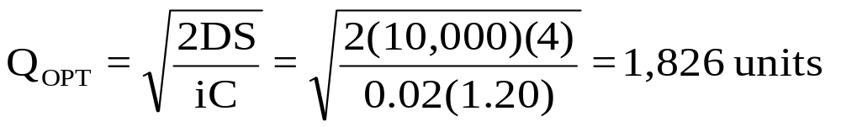
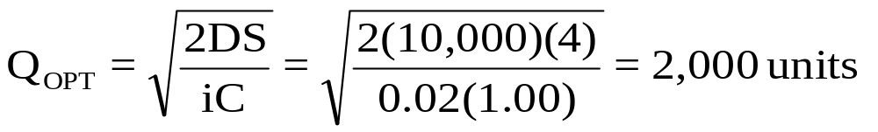
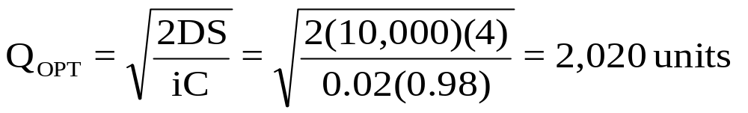
Price-Break Example Solution (Part 2)
First, plug data into formula for each price-break value of “C”
Annual Demand (D)= 10,000 units
Cost to place an order (S)= $4
Carrying cost % of total cost (i)= 2%
Cost per unit (C) = $1.20, $1.00, $0.98
Next, determine if the computed Q_{opt} values are feasible or not
Interval from 0 to 2499, the Q_{opt} value is feasible
Interval from 2500-3999, the Q_{opt} value is not feasible
Interval from 4000 & more, the Q_{opt} value is not feasible
Notes:
15

Slide 29
Price-Break Example Solution (Part 3)
Since the feasible solution occurred in the first price-break, it means that all the other true Q_{opt} values occur at the beginnings of each price-break interval. Why?
Because the total annual cost function is a “u” shaped function
Total annual costs
So the candidates for the price-breaks are 1826, 2500, and 4000 units
0 1826 2500 4000 Order Quantity
Notes:
15

Slide 30
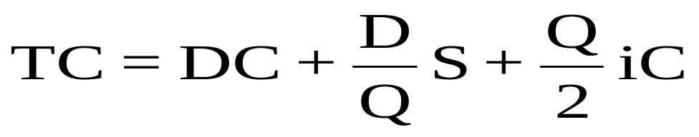
Price-Break Example Solution (Part 4)
Next, we plug the true Q_{opt} values into the total cost annual cost function to determine the total cost under each price-break
TC(0-2499)=(10000*1.20)+(10000/1826)*4+(1826/2)(0.02*1.20)
= $12,043.82
TC(2500-3999)= $10,041
TC(4000&more)= $9,949.20
Finally, we select the least costly Q_{opt}, which is this problem occurs in the 4000 & more interval. In summary, our optimal order quantity is 4000 units
Notes:
15

Slide 31
Miscellaneous Systems:
Optional Replenishment System
Maximum Inventory Level, M
q = M - I
Actual Inventory Level, I
M
I
Q = minimum acceptable order quantity
If q > Q, order q, otherwise do not order any.
Notes:
24

Slide 32

Miscellaneous Systems:
Bin Systems
Two-Bin System
Order One Bin of
Inventory
Full
Empty
One-Bin System
Order Enough to
Refill Bin
Periodic Check
Notes:
25

Slide 33
ABC Classification System
Items kept in inventory are not of equal importance in terms of:
  dollars invested
  profit potential
  sales or usage volume
  stock-out penalties
60
% of
$ Value
A
30
B
0
C
% of
Use
30
60
So, identify inventory items based on percentage of total dollar value, where “A” items are roughly top 15 %, “B” items as next 35 %, and the lower 65% are the “C” items
Notes:
26

Slide 34
Inventory Accuracy and Cycle Counting
Defined
Inventory accuracy refers to how well the inventory records agree with physical count
Cycle Counting is a physical inventory-taking technique in which inventory is counted on a frequent basis rather than once or twice a year
Notes:
27

Slide 35
End of Chapter 14
Notes:
2

